Slide 1


The Cameramen
Zechariah Sawyers, Tyler Letner, Chance Engstrom, and Jonathon Slater

Slide 2
Our Goals
To stabilize video
To achieve this, we used a gyroscope in conjunction with a Servo.
We hoped to see less spin in the video than last semester

Slide 3
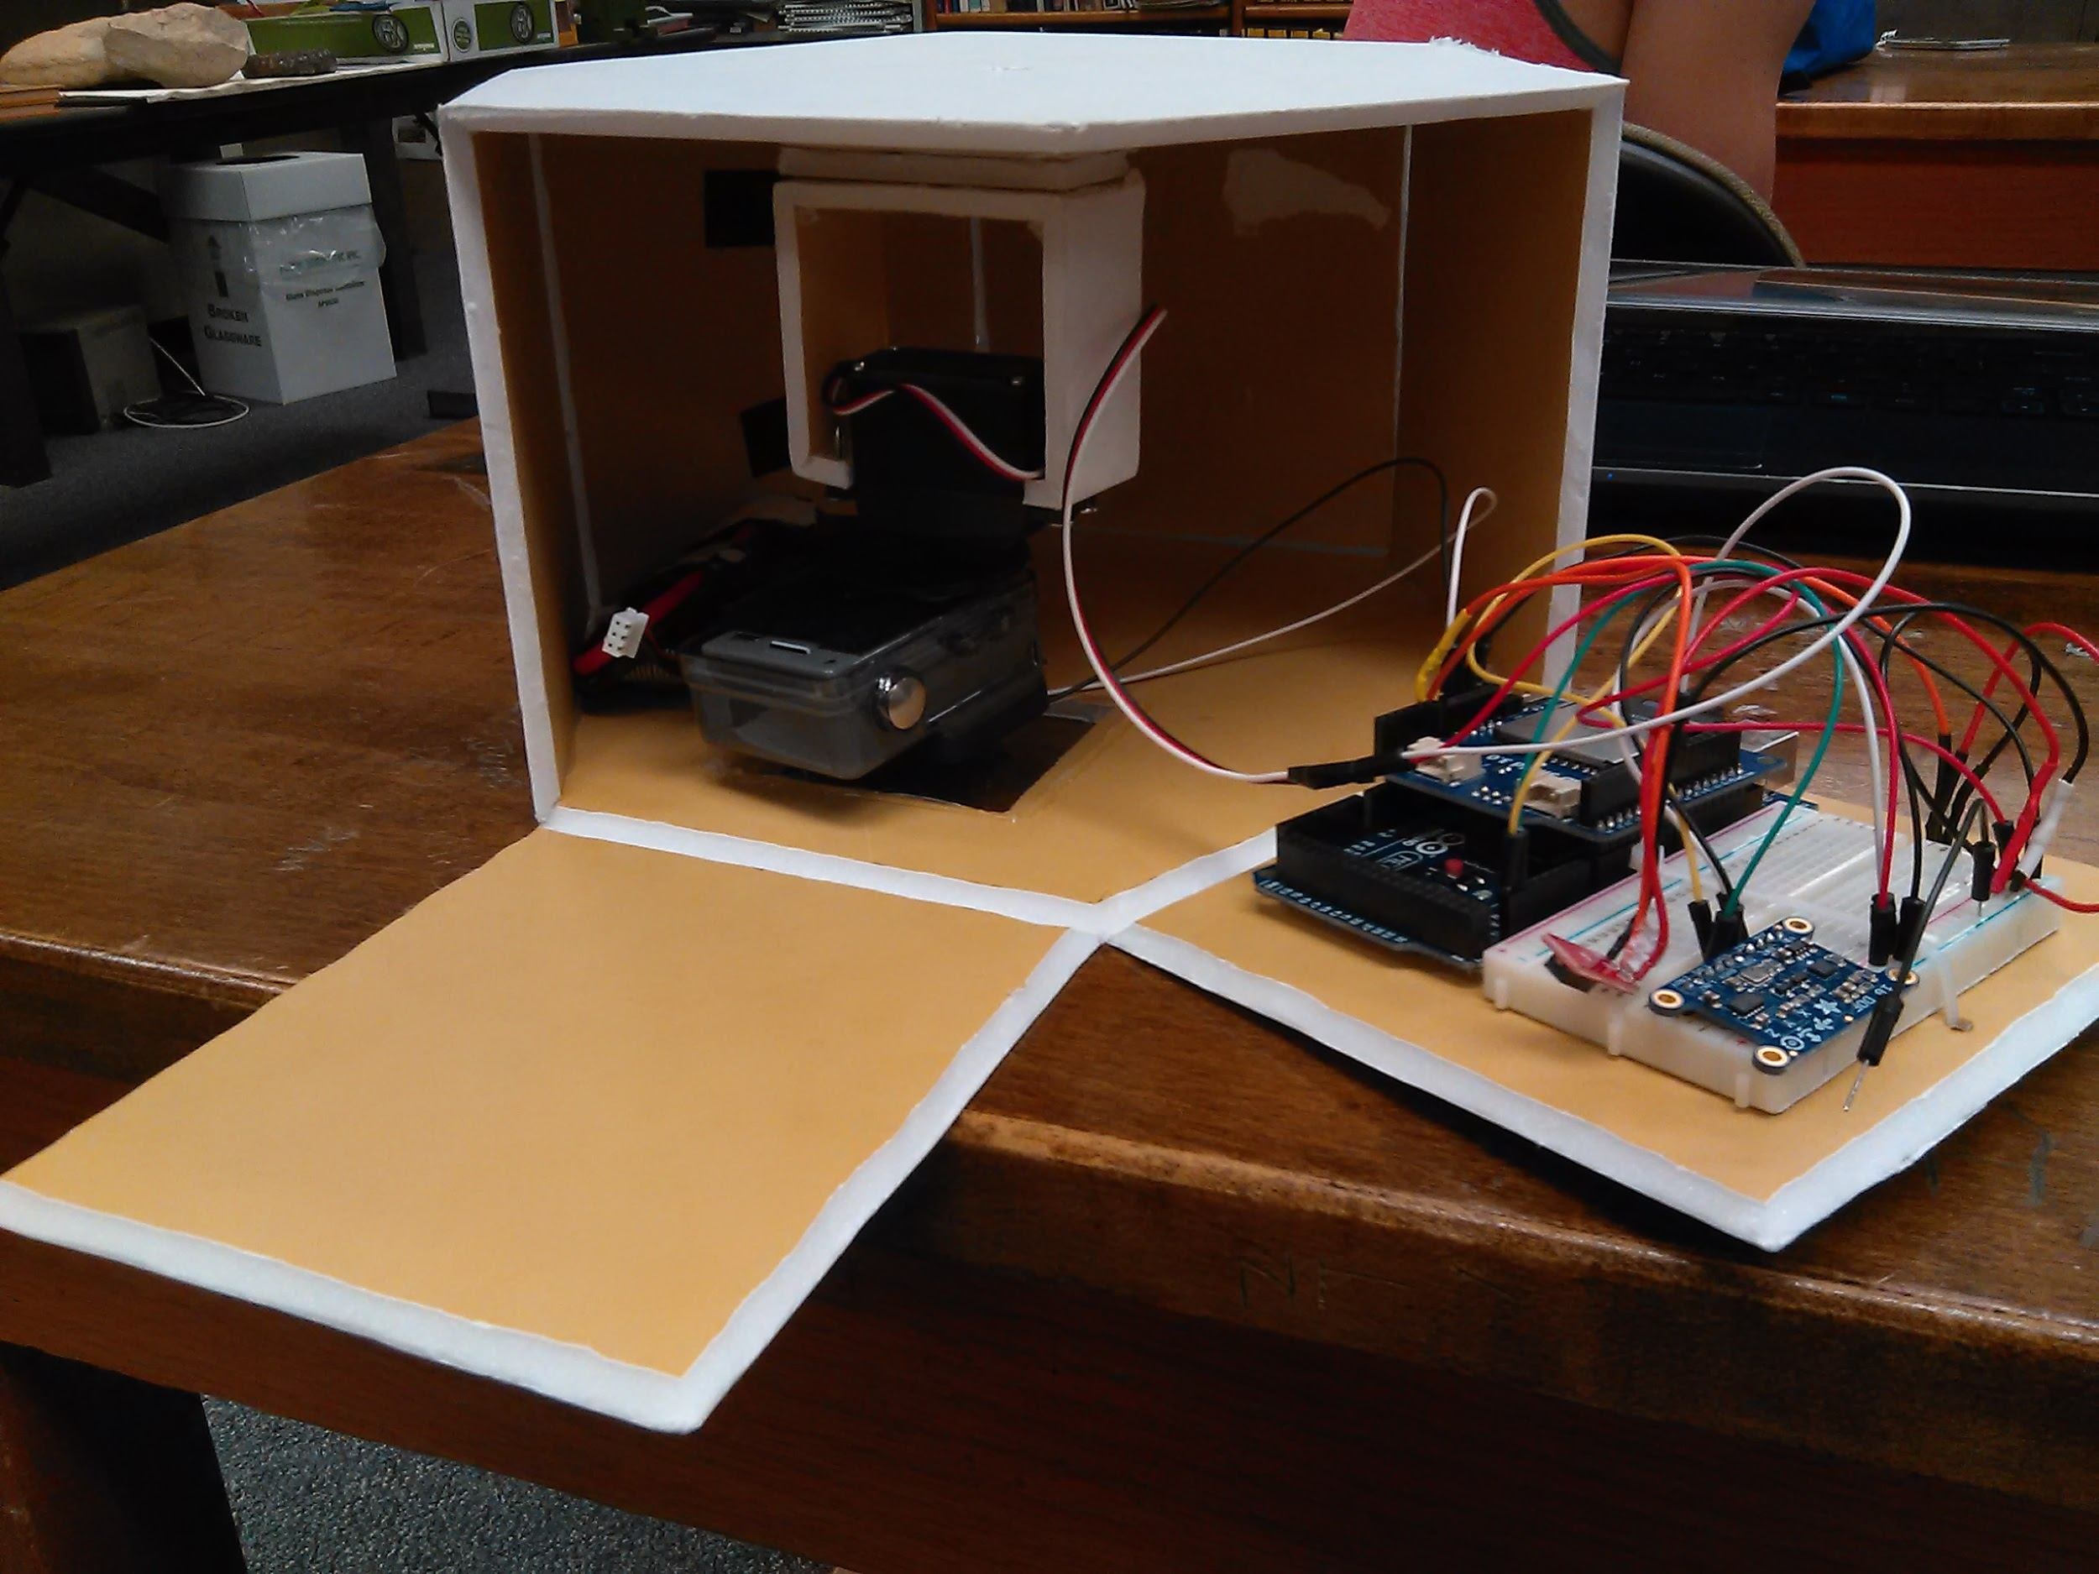
The Payload: I.S.S.A.C.
In-Flight
Spin
Stabilizing
Aerial
Camera

Slide 4
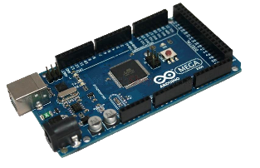
Hardware
Arduino Mega
Initially we were going to use an Arduino Uno but found it had insufficient memory.
We included a stackable SD Shield which reduced the wiring and code required to record data.
Adafruit 10 DoF breakout
Includes Gyroscope, Accelerometer, Altimeter, and Magnetometer.
TMP 36
To measure external temperature

Slide 5
Programming
“It kind of works, because I kind of programmed it”
- Chance
The system is designed to export all data to a .csv file which is editable and formatted in excel
The most difficult portion involved the manipulation of the servo

Slide 6
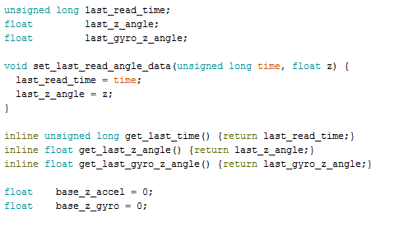
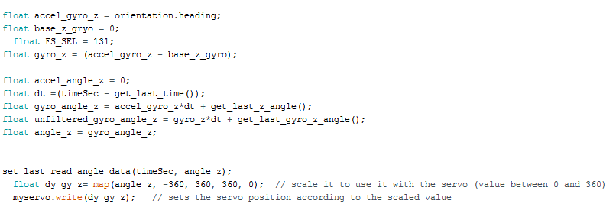
The Code
Before (Nonfunctional)
After (Functional)
Before (non functional)

Slide 7
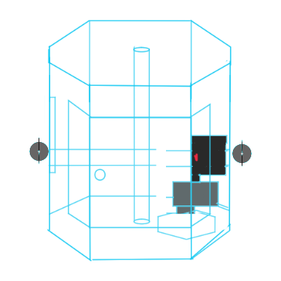
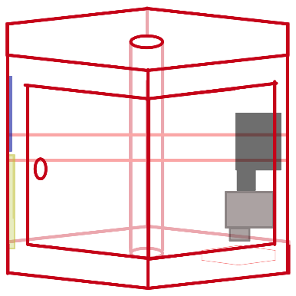

Case Design
Foam board was used to make the case in order to make it light
Hexagonal Prism
Better mounting surfaces
Better weight distribution
Viewing window made from polyurethane
The design went through a few iterations.

Slide 8
What We Found
Failure of camera and circuit board mounts.
Coding glitches-
Camera twitches
Proof of concept for stabilization
Electronics fail at -10°C

Slide 9
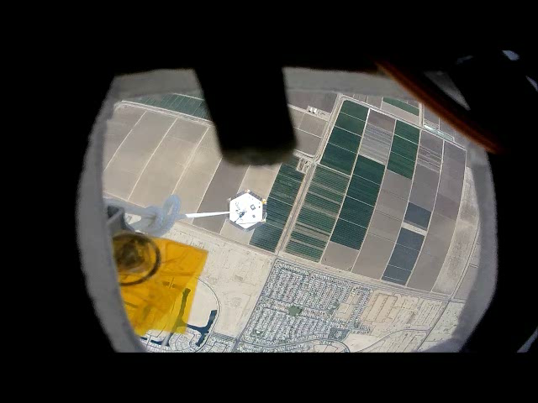
Servo Working with Gyroscope
The servo is moving according to the heading from the gyroscope, showing that stabilization is possible.

Slide 10
How we can improve
Better mounting for the camera
3-D Printed mount?
Better mounting for the circuit board
Reduce weight with project board
Add On/Off switch
Using accelerometer to help stabilization
Refine case design for better access to hardware.
Two circuit boards
Stepper motor instead of servo

Slide 11
Acknowledgments:
Arizona Space Grant Consortium
Our Professors: Tammy Janisko & Dr. Pryor
Mr. Crabtree & ANSR Volunteers
Fellow Students
Adafruit.com

Slide 12
Thank You!

